Slide 1

Introduction to Finite Volume Methods
A practical and mildly historical development of Finite Volume Methods for transport problems
Jon Staggs
PhD Student at Oden Institute,
The University of Texas at Austin
Email:
Jon.Staggs@utexas.edu

Slide 2
Outline of Talk
0) Background, Motivation, and Goals
1) Lessons from Finite Differences
Stability, Diffusion & Dispersion, Godunov’s Barrier Theorem
2) Fundamentals of Finite Volume
Conservation/Integral form, REU Framework
3) Limiters and MUSCL Schemes
Flux/Slope Limiters, Monotone Schemes
4) Basic idea of ENO/WENO (I didn’t have time to code this)
"Essentially Non Oscillatory”, pick the right grid
5) Closing Remark, Remaining Questions, Future Directions, etc.,

Slide 3
Motivation and Goals for this talk
My motivations for learning Finite Volume Methods (FVM) are two fold:
1. Numerical Analysis is (usually) taught poorly and seems boring
Taylor Series -> Finite Differences + Error
Poisson and Heat Equation
Mess of methods and no idea when to use what
​
2. My Research/Understanding "legacy" code that was given to me
Given some code so should try to really understand it
Lots of people in "structured population modeling" use FVM and I didn't know why

Slide 4


Motivation and Goals for this talk
General motivation and reason to care about FVM
1. Transport is important
Movement of *anything* across space
Fluids, gases, animals, wind, disease, etc.,
Kinetics (hot topic right now - Tokamaks and Fusion energy
2. Shocks show up all the time
Physically
Water waves, fractures in solids, explosions
Practically - whenever “cohorts” cross
Size Structured Population (related to my research):
Tracking distribution of sizes and one class grows fast and intersects with another (characteristics cross)

Slide 5
Motivation and Goals for this talk
Idealistic goals:
1. Convince you numerical analysis is not boring
​
2. Show in an intuitive way why FVMs were developed and when you should use them

Slide 6
Motivation and Goals for this talk
What to expect
1. This is mostly practical - lots of simulations and "discovery based learning"
2. A few computations/derivations
​
3. A couple of theorems (without proof)

Slide 7
Lessons from Finite Differences
The set up:
We want to approximate transport/conservation equations:
$$\frac{∂u}{∂t}=-∇_{x}⋅f(u)$$
Two model problems:
Advection: $f(x)=x$
Burger’s: $f(x)=x^{2}$
$$u_{t}=-(\frac{u^{2}}{2})_{x}=uu_{x}$$
$$u_{t}=-u_{x}$$
+ two basic initial conditions (Gaussian and Square) give us a rich enough set to understand:
1. How smooth solutions propagate (Gaussian I.C. with advection)
2. How shocks propagate (square wave I.C. with advection)
2.5 and how shocks develop (Burger's)

Slide 8
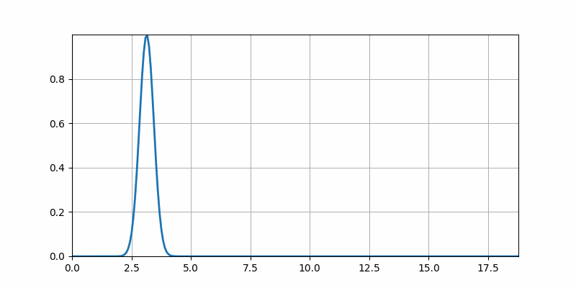
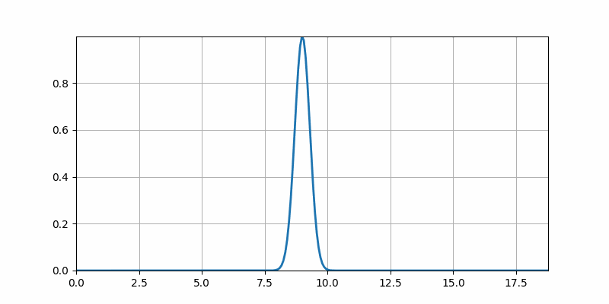
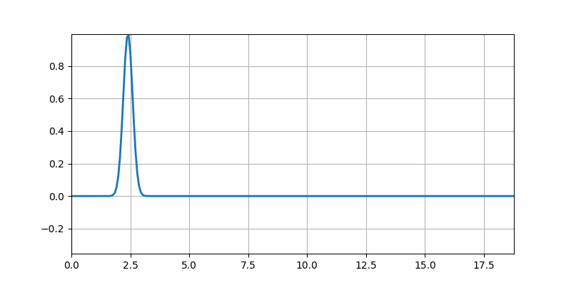
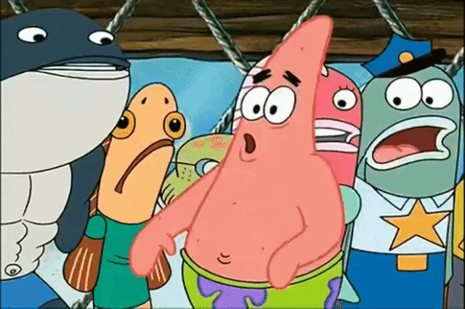

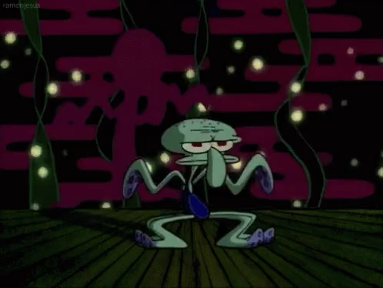
Intermezzo
Physical Intuition
Transport:
Diffusion:
Dispersion:
$$u_{t}=-vu_{x}$$
$$u_{t}=du_{xx}$$
$$u_{t}=u_{xxx}$$

Slide 9
Lessons from Finite Differences
Quick remark on notation:
$$u_{i}^{n}≈u(x_{i},t_{n})$$
The numerical approximation to the true value
at the discrete spatial point, $x_{i}$, and discrete time point, $t_{n}$
We discretize our spatial grid* $[x_{start},x_{end}]$ by $x_{i}$$=x_{start}+iΔx$
Similarly, we discretize our temporal grid, $[0,t_{max}]$ by $t_{n}$$=nΔt$

Slide 10
Lessons from Finite Differences
The simplest thing you can do
Upwinding (i.e. Forward Euler in time and Forward Euler in space)
$$\frac{u_{i}^{n+1}-u_{i}^{n}}{Δt}=-v\frac{u_{i}^{n}-u_{i-1}^{n}}{Δx}$$
If you wanted to do a double for loop for the update:
$$u_{i}^{n+1}=u_{i}^{n}-v\frac{Δt}{Δx}(u_{i}^{n}-u_{i-1}^{n})$$

Slide 11
Lessons from Finite Differences
Upwinding for linear advection
Generally, we put things in Matrix-vector Notation:
$${\overset{⃗}{u}}^{n+1}=-A{\overset{⃗}{u}}^{n}$$
Here A is (just $1-α$ on the diagonal and $α$ on the subdiagonal)
$$\left[\begin{matrix}1-α & 0 & ⋯ & 0 \\ α & 1-α & 0 & ⋯ \\ 0 & α & ⋱ & ⋯ \\ ⋮ & ⋱ & & \end{matrix}\right]$$
with $α=v\frac{Δt}{Δx}$

Slide 12
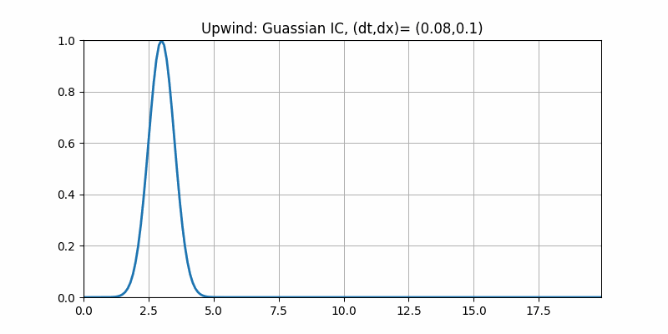
Lessons from Finite Differences
Upwinding for linear advection
Why are we getting some diffusion...? Maybe our grids were too course?

Slide 13
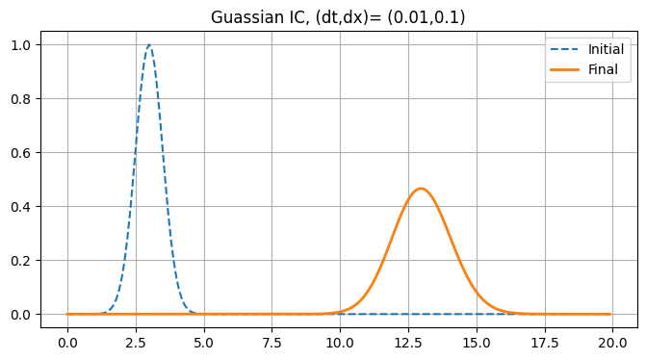
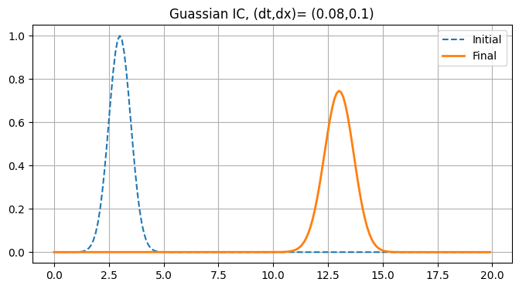
Lessons from Finite Differences
Upwinding for linear advection
Try refining time grid
Original
Smaller $Δt$
Hmmm... that seemed to make it worse. Try refining x?

Slide 14
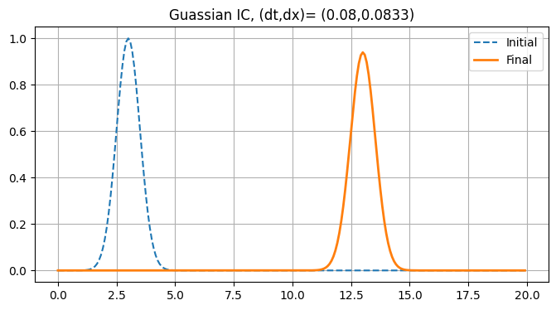
Lessons from Finite Differences
Upwinding for linear advection
Refining x grid
Original
Smaller $Δx$
That looks better but we would like to minimize the diffusion so let's refine some more

Slide 15
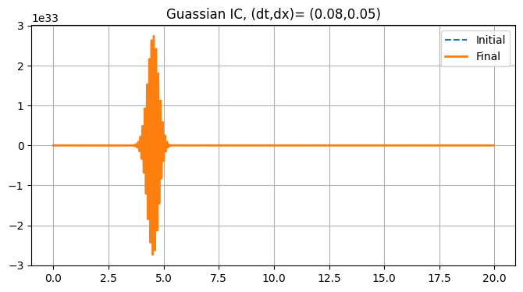
Lessons from Finite Differences
Upwinding for linear advection
Refining x grid more
Even smaller $Δx$
Original
Smaller $Δx$
:(

Slide 16
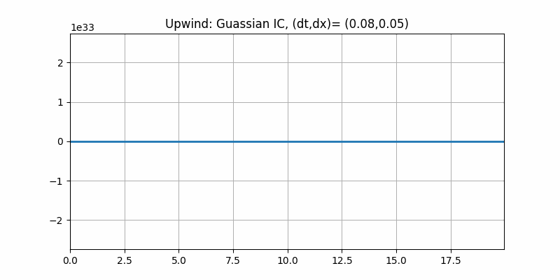
Lessons from Finite Differences
Stability
This behavior is a loss of numerical stability.
Stability means: Small errors don't grow arbitrarily large
(Same notion as linear stability: perturbations don’t send you flying off. Perturbations here are round off errors)
Clearly we see error growing out of control (Look at scale)

Slide 17
Lessons from Finite Differences
Stability and Lax Equivalence Theorem
Lax Equivalence Theorem:
Linear consistent finite difference method for a well posed linear IVP, the method is convergent if and only if the method is stable
To converge to our true solution we need to refine our grids and the above says we will only get this convergence if we maintain stability
But... we tried to refine x and lost stability so we really need to understand this stability issue

Slide 18
Lessons from Finite Differences
Convergence, stability, etc.,
As a Recap:
1. Want to approximate transport/conservation equation
but we see diffusion
2. We find refining x grid “lessens” diffusion
but too much refinements leads to loss of stability
3. We investigate further…

Slide 19
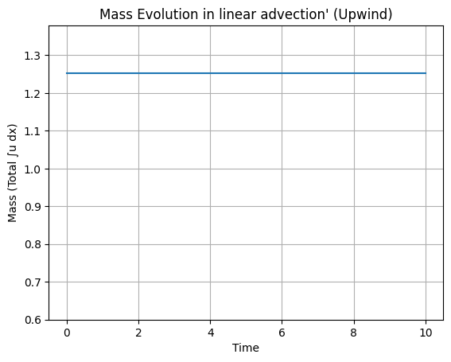
Lessons from Finite Differences
Why do we care about this diffusion?
We are simulating conservation laws. Hard to tell if diffusion is leading to mass loss!
Let’s check with advection:
Yay! No mass loss
Is this always the case? Try a shock case with Burgers

Slide 20
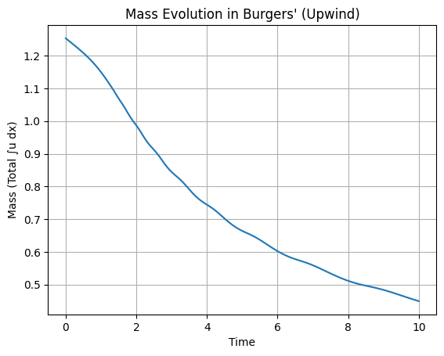
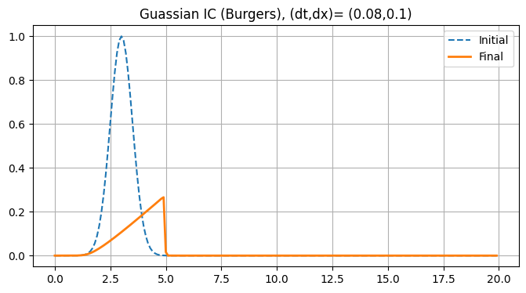
Lessons from Finite Differences
Why do we care about this diffusion?
Upwinding with Burgers:
$$u_{t}=-uu_{x}$$
Big Burger mass loss.

Slide 21
Lessons from Finite Differences
Stability of Upwinding
We have our scheme:
$${\overset{⃗}{u}}^{n+1}=-A{\overset{⃗}{u}}^{n}$$
With
$$A=\left[\begin{matrix}1-α & 0 & ⋯ & 0 \\ α & 1-α & 0 & ⋯ \\ 0 & α & ⋱ & ⋯ \\ ⋮ & ⋱ & & \end{matrix}\right]$$
and $α=v\frac{Δt}{Δx}$
Notice that
What would stability mean here mathematically?
$${\overset{⃗}{u}}^{n+1}=A{\overset{⃗}{u}}^{n}=A^{n}{\overset{⃗}{u}}^{0}$$
Then due to round off we have something like
$${\overset{⃗}{u}}^{0}={\overset{⃗}{u}}_{true}+ϵ$$
. Then we have,
$$A^{n}{\overset{⃗}{u}}^{0}=A^{n}{\overset{⃗}{u}}_{true}+A^{n}ϵ$$
$←$ Need to control

Slide 22
Lessons from Finite Differences
Stability of Upwinding
We want A to be bounded so we can control growth of error and have control over our approximation,$||{\overset{⃗}{u}}^{n}||$.
We want for all n:
$$\begin{matrix}||{\overset{⃗}{u}}^{n}|| & =||A^{n}{\overset{⃗}{u}}^{0}|| \\ & ≤||A^{n}||||{\overset{⃗}{u}}^{0}|| \\ & ≤C||{\overset{⃗}{u}}^{0}||\end{matrix}$$
We use infinity norm and since every row only has $α$ and $1-α$ then $||A||_{∞}=|α|+|1-α|$. Notice we will have $||A||_{∞}=1$ only if $0≤α≤1$
Since $||A^{n}||≤||A||^{n}$ then we obtain our desired boundedness only if $α≤1$
Therefore, we require $α=v\frac{Δt}{Δx}≤1$

Slide 23
Lessons from Finite Differences
Stability of Upwinding
Our stability condition $α=v(Δt/Δx)$ explains why too much x refinement gives instability (from a mathematical perspective)
Point: If we want control diffusion (or mass loss) we actually need to *doubly* refine our grid (both $Δt\text{and}Δx→0$) but this is expensive! Moreover, we still have diffusion. Can we avoid it?

Slide 24
Lessons from Finite Differences
Model Equation Approach
We are about to do a semi tedious computation...
Idea: We know our scheme will converge to true solution at the grid points *asymptotically*, however, maybe we are actually approximating a modified equation more accurately in the "coarse grid regime"

Slide 25
Lessons from Finite Differences
Model Equation - the computation
Consider our scheme:
$$\frac{u_{i}^{n+1}-u_{i}^{n}}{Δt}=-v\frac{u_{i}^{n}-u_{i-1}^{n}}{Δx}$$
$$u_{i}^{n+1}=u_{i}^{n}-v\frac{Δt}{Δx}(u_{i}^{n}-u_{i-1}^{n})$$
$$⟺$$
Suppose that a continuous function w satisifes the above relation *exactly* at the discrete grid points so:
$$w(x,t+Δt)=w(x,t)-v\frac{Δt}{Δx}(w(x,t)-w(x-Δx,t))$$
$$↑$$
$$↑$$
Taylor expand…

Slide 26
Lessons from Finite Differences
Model Equation - the computation
Divided Diff. Formula:
$$w(x,t+Δt)=w(x,t)+Δtw_{t}(x,t)+\frac{(Δt)^{2}}{2!}w_{tt}(x,t)+⋯$$
$$\frac{u_{i}^{n+1}-u_{i}^{n}}{Δt}+v\frac{u_{i}^{n}-u_{i-1}^{n}}{Δx}=0$$
$$w(x-Δx,t)=w(x,t)-Δxw_{x}(x,t)+\frac{(Δx)^{2}}{2!}w_{xx}(x,t)-⋯$$
Plug into divided difference formula,
$$(w_{t}+\frac{Δt}{2!}w_{tt}+\frac{(Δt)^{2}}{3!}w_{ttt}+⋯)$$
$$+v(w_{x}-\frac{Δx}{2!}w_{xx}+\frac{(Δx)^{2}}{3!}w_{xxx}+⋯)=0$$
$$w_{t}+vw_{x}=\frac{1}{2!}(vΔxw_{xx}-Δtw_{tt})-\frac{1}{3!}(v(Δx)^{2}w_{xxx}+(Δt)^{2}w_{ttt})+O((Δx)^{2},(Δt)^{2})$$
$$⟺$$

Slide 27
Lessons from Finite Differences
Model Equation - the computation
$$w_{t}+vw_{x}=\frac{1}{2!}(vΔxw_{xx}-Δtw_{tt})-\frac{1}{3!}(v(Δx)^{2}w_{xxx}+(Δt)^{2}w_{ttt})+O((Δx)^{2},(Δt)^{2})$$
This is the full PDE our scheme satisfies.
Notice if we drop the entire right hand side we recover our original PDE. We are satisfying our desired PDE up to first order (which we knew).
Now if we keep the first order terms:
$$w_{t}+vw_{x}=\frac{1}{2!}(vΔxw_{xx}-Δtw_{tt})+O(Δx^{2},Δt^{2})$$
This is the PDE our scheme satisfies up to second order.

Slide 28
Lessons from Finite Differences
Model Equation - the computation
$$w_{t}+vw_{x}=\frac{1}{2!}(vΔxw_{xx}-Δtw_{tt})+O(Δx^{2},Δt^{2})$$
(*)
Now we do a trick to reduce this.
Take (*) and differentiate through by $t$
and by $x$
$$∂_{t}(*):w_{tt}=-vw_{xt}+\frac{1}{2}(vΔxw_{xxt}-Δtw_{ttt})$$
$$∂_{x}(*):w_{tx}=-vw_{xx}+\frac{1}{2}(vΔxw_{xxx}-Δtw_{ttx})$$
This gives us:
$$w_{tt}=v^{2}w_{xx}+O(Δx,Δt)$$

Slide 29
Lessons from Finite Differences
Model Equation - Diffusion revealed
$$w_{t}+vw_{x}=\frac{1}{2!}(vΔxw_{xx}-Δtw_{tt})+O(Δx^{2},Δt^{2})$$
This explains why:
Why our scheme diffuses out
Refining $Δ$$x$ makes diffusion get weaker
3. Refining just $Δt$ made diffusion worse
$$w_{tt}=v^{2}w_{xx}+O(Δx,Δt)$$
$$⟹w_{t}+vw_{x}=\frac{1}{2}(vΔxw_{xx}-Δtv^{2}w_{xx})$$
$$=\frac{1}{2}vΔx(1-v\frac{Δt}{Δx})w_{xx}$$
$$=\frac{1}{2}vΔx(1-α)w_{xx}$$
We are actually approximating (up to second order) a PDE with diffusion!
$$←$$

Slide 30
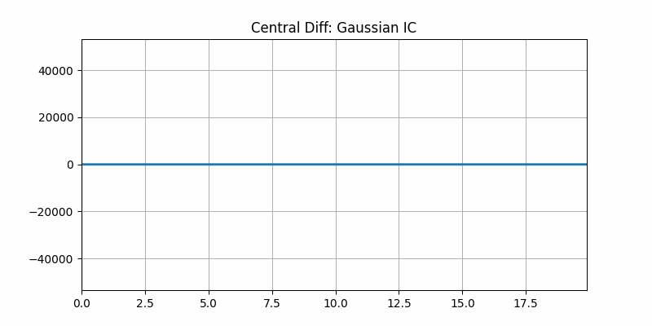
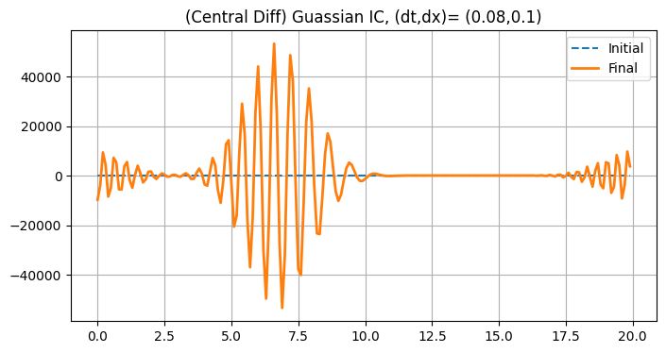
Lessons from Finite Differences
Another scheme?
Upwinding has its issues... maybe just try a different scheme? Next easiest is central difference in space
$$u_{i}^{n+1}=u_{i}^{n}-v\frac{Δt}{2Δx}(u_{i+1}^{n}-u_{i-1}^{n})$$
Turns out to be unconditionally unstable... It always blows up

Slide 31
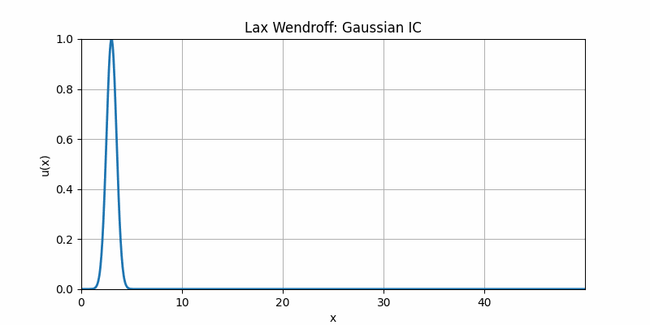
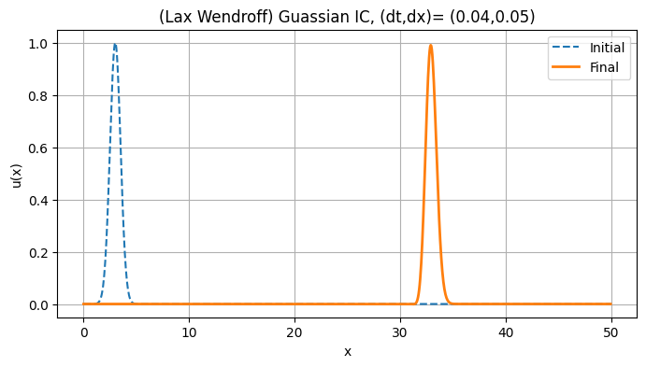
Lessons from Finite Differences
Lax Wendroff Scheme for Linear Advection
We'll pick a different, but stable scheme LW (2nd order space and time. This has same stability criteria as upwinding) but 2nd order so if we have diffusion it’s cheaper to refine it away
Yay! No diffusion!

Slide 32
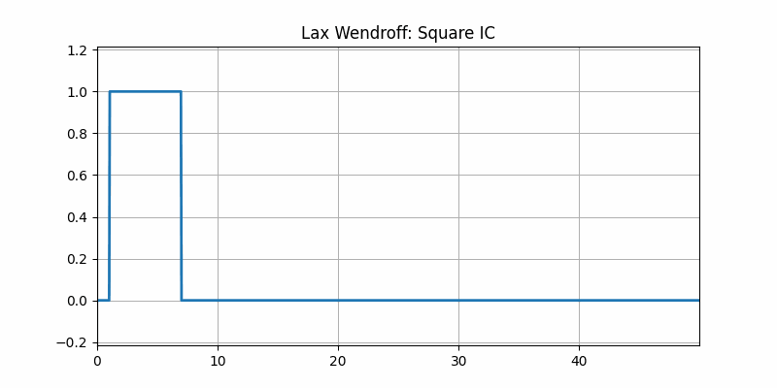
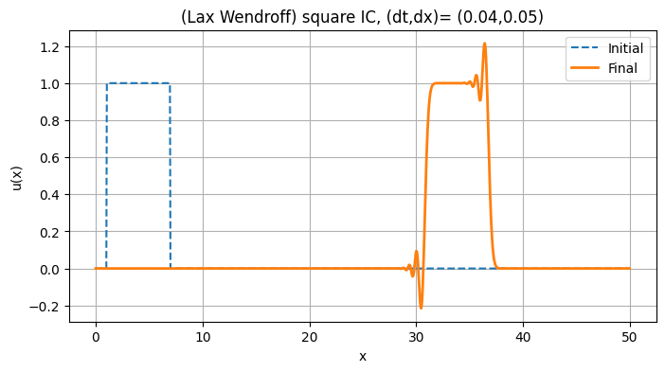
Lessons from Finite Differences
Lax Wendroff Scheme for Linear Advection with sharp wave front
Let's see what happens when we propagate a sharp wave front/shock
:( Unexpected oscillations, but not like those from instability.
This is called numerical dispersion - repeat model equation approach and you end up with a left over $u_{xxx}$ (dispersive) term

Slide 33
Lessons from Finite Differences
Godunov's Barrier Theorem and Takeaway from Finite Differences
We see the fundamental tension: Low order + diffusion or High order + dispersion
(all while stability needs to be watched in the background and we still don’t have a handle on conservation in shock cases)
Godunov's Barrier Theorem:
Linear Schemes (for PDEs) that are monotone, can be at most first order accurate.

Slide 34
Fundamentals of Finite Volume Method
History-ish
Godunov's Barrier poses a real issue, but trends at the time suggested an alternative approach that might be better suited for transport+shocks and may be easier to adapt.
The philosophical idea: develop a more problem specific method instead of using generic method (finite differences). We are working with conservation laws so is there a way to exploit the physics?
Historically, FVM is being developed in 50s and 60s. Shocks are "weak solutions" (generalized functions/distributions/integral forms). These ideas started in the 30s, but were seriously developed in the 50s in the USSR (Sobolev, etc.,). Godunov (also in the USSR) pioneered much of the work on FVM so integral forms/methods were especially natural at the time.

Slide 35
Fundamentals of Finite Volume Method
Conservation form of the PDE
Subdivide domain into cells around our discrete points
Start with conservation form of PDE:
$$\frac{∂u}{∂t}=-∇_{x}⋅f(u)$$
$$x_{i}$$
$$x_{i+1}$$
{
{
We compute the evolution of volume over a single cell
Cell i
Cell i+1
$$∫_{C_{i}}u_{t}dV+∫_{C_{i}}∇⋅f(u)dV=0$$
Integrating and invoking divergence theorem
$$\text{Vol}(C_{i})\frac{∂\overline{u}}{∂t}+∫_{∂C_{i}}f(u)⋅\overset{⃗}{n}dS=0$$
$$\overline{u}=\frac{1}{\text{Vol}(C_{i})}∫_{C_{i}}udV$$
With
(i.e. cell average)

Slide 36
Fundamentals of Finite Volume Method
Conservation form of the PDE
$$\text{Vol}(C_{i})\frac{∂\overline{u}}{∂t}+∫_{∂C_{i}}f(u)⋅\overset{⃗}{n}dS=0$$
$$\overline{u}=\frac{1}{\text{Vol}(C_{i})}∫_{C_{i}}udV$$
With
(i.e. cell average)
Switching to 1D (so volume is just $Δx$) and representing the fluxes through the cell boundaries as a function, F
$$∫_{∂C_{i}}f(u)dS=F(u(x_{i+1/2}^{-},t))-F(u(x_{i-1/2}^{+},t)):=F_{i+1/2}(t)-F_{i-1/2}(t)$$
$$x_{i-1/2}^{+}$$
$$x_{i+1/2}^{-}$$
$$x_{i}$$
$$x_{i+1}$$
Shift in perspective: evolving cell averages - not evaluating point wise
{
{
Cell i
Cell i+1

Slide 37
Fundamentals of Finite Volume Method
The Finite Volume Scheme
This gets us to the typical presentation of the Semi Discrete Finite Volume Method
$$\text{Vol}(C_{i})\frac{∂\overline{u}}{∂t}+∫_{∂C_{i}}f(u)⋅\overset{⃗}{n}dS=0$$
$$\frac{∂\overline{u}}{∂t}+\frac{1}{Δx}(F_{i+1/2}(t)-F_{i-1/2}(t))=0$$
$$→$$
If we select forward Euler we obtain the discrete scheme:
$$u_{i}^{n+1}=u_{i}^{n}-\frac{Δt}{Δx}(F_{i+1/2}-F_{i-1/2})$$
The user must now pick how to compute the numerical fluxes! Different schemes are defined by how the fluxes built and evaluated
We get guaranteed conservation and have no mesh dependencies (just need cell avg)

Slide 38
Fundamentals of Finite Volume Method
Finite Volume Method
We want to evaluate our numerical fluxes so we know how much mass is passing through our cell boundaries.
To do this we need the *pointwise value* of the function, $u$, at the interfaces:$F(u(x_{i+1/2}^{-},t))$
We only have access to the cell averages, ${\overline{u}}_{i}$. We will use these averages to “reconstruct” $u$ at the interface.
We use these approximations to evaluate our numerical flux.
Different schemes are 1) different ways to reconstruct and 2) different choices of numerical fluxes

Slide 39
Fundamentals of Finite Volume Method
Finite Volume Method: Godunov Scheme
We move on to the development of the "Godunov Scheme"
A Godunov Scheme means you choose your numerical fluxes to be the solution to a local/cell Riemann Problem evaluated the interface.

Slide 40
Fundamentals of Finite Volume Method
Riemann Problem
A Riemann Problem is the conservation law at hand with piecewise constant initial data
$$u_{t}=-∇_{x}⋅f(u)$$
$$u(x,0)=\{\begin{aligned}{\overline{u}}_{i},x<x_{i+1/2} \\ {\overline{u}}_{i+1},x>x_{i+1/2}\end{aligned}$$
$$u(x,0)=\{\begin{aligned}u_{L},x<0 \\ u_{R},x>0\end{aligned}$$
$${\overline{u}}_{i}$$
$$x_{i+1/2}$$
$${\overline{u}}_{i+1}$$
$$x_{i}$$
$$x_{i+1}$$
{
{
Cell i
Cell i+1

Slide 41
Fundamentals of Finite Volume Method
Riemann Problem
Why is this something we even want to look at?
$${\overline{u}}_{i}$$
$$x_{i+1/2}$$
$${\overline{u}}_{i+1}$$
$$u(x,0)=\{\begin{aligned}{\overline{u}}_{i},x<i+1/2 \\ {\overline{u}}_{i+1},x>i+1/2\end{aligned}$$
$$x_{i}$$
$$x_{i+1}$$
$$u_{t}=-∇_{x}⋅f(u)$$
{
{
Cell i
Cell i+1
We are taking a cell mass, ${\overline{u}}_{i}$, (a constant at each time) and transporting it across an interface (i.e. $i+1/2$) and we want to transport it according to our problem specific flux, $f$
Solving this Riemann problem and evaluating its solution at the interface is actually exactly what we want
Note: We are using a piecewise constant reconstruction of $u$ (so just first order accuracy here)

Slide 42
Fundamentals of Finite Volume Method
First order Godunov Scheme Recap
$$u_{i}^{n+1}=u_{i}^{n}-\frac{1}{Δx}(F_{i+1/2}-F_{i-1/2})$$
Need to evaluate numerical fluxes with point wise (interface) values, $F(u(x_{i+1/2}^{-},t))$
1. Reconstruct $u_{i}^{n},u_{i+1}^{n}$ using cell averages, ${\overline{u}}_{i}$
2. We solve our Riemann problem an get back a (piecewise) function, $u$
3. Evaluate this Riemann problem solution at the interface, $u^{*}=u(x_{i+1/2},t)$
4. Plug interface value into flux, $F(u^{*})=F_{i+1/2}$

Slide 43
Fundamentals of Finite Volume Method
Solving the Riemann Problem for Linear Advection
$$u_{t}=vu_{x}$$
Assume $v>0$
$$u(x,0)=\{\begin{aligned}{\overline{u}}_{i},x<x_{i+1/2} \\ {\overline{u}}_{i+1},x>x_{i+1/2}\end{aligned}$$
$$\frac{dx}{dt}=v⟹x=x_{0}+vt$$
Then $u(x,t)=u_{0}(x-vt)$.
Solve via characteristics:
Now plug into our Riemann data (which side of the interface you’re on)
$$u(x,t)=\{\begin{aligned}{\overline{u}}_{i},x-vt<x_{i+1/2} \\ {\overline{u}}_{i+1},x-vt>x_{i+1/2}\end{aligned}$$

Slide 44
Fundamentals of Finite Volume Method
Solving the Riemann Problem for Linear Advection
$$u_{t}=-vu_{x}$$
$$(v>0)$$
$$u(x,t)=\{\begin{aligned}{\overline{u}}_{i},x-vt<x_{i+1/2} \\ {\overline{u}}_{i+1},x-vt>x_{i+1/2}\end{aligned}$$
$$u(x,0)=\{\begin{aligned}{\overline{u}}_{i},x<x_{i+1/2} \\ {\overline{u}}_{i+1},x>x_{i+1/2}\end{aligned}$$
Has solution:
$$t=Δt:$$
$$t=0:$$
$${\overline{u}}_{i-1}$$
$${\overline{u}}_{i-1}$$
$$x_{i+1/2}$$
$${\overline{u}}_{i-1}$$
{
{
$$x_{i}$$
$$x_{i+1}$$
Cell i
Cell i+1

Slide 45
Fundamentals of Finite Volume Method
Solving the Riemann Problem for Linear Advection
$$u_{t}=-vu_{x}$$
$$(v>0)$$
$$u(x,t)=\{\begin{aligned}{\overline{u}}_{i},x-vt<x_{i+1/2} \\ {\overline{u}}_{i+1},x-vt>x_{i+1/2}\end{aligned}$$
$$u(x,0)=\{\begin{aligned}{\overline{u}}_{i},x<x_{i+1/2} \\ {\overline{u}}_{i+1},x>x_{i+1/2}\end{aligned}$$
Has solution:
So our solution evaluated at the interface: $u(x_{i+1/2},t)={\overline{u}}_{i}$
Now plugging into our flux ($f(x)=vx$) gives $f(u(x_{i+1/2}))=v{\overline{u}}_{i}$ and $f(u(x_{i-1/2}))=v{\overline{u}}_{i-1}$
We now have:
$$u_{i}^{n+1}=u_{i}^{n}-\frac{Δt}{Δx}(F_{i+1/2}-F_{i-1/2})$$
$$u_{i}^{n+1}=u_{i}^{n}-v\frac{Δt}{Δx}(u_{i}-u_{i-1})$$
$$→$$
This is just upwinding! This is why upwinding was actually conserving mass.

Slide 46
Fundamentals of Finite Volume Method
But we just solved our PDE to solve our PDE…?
Yes and that’s how it look for simple linear problems, but with non linear problems where shocks form we cannot get global analytical solutions
We are solving a local, idealized version of the PDE. We don’t need the global solution in this case. We just need the interface behavior.
This piecewise, local approach let’s us correctly propagate discontinuities so that we maintain conservation.
Note: analytically solving Riemann problem is not alway feasible so often use an approximation technique (Roe, HLL, etc., - works by simplifying the advection function for the Riemann problem)

Slide 47
Fundamentals of Finite Volume Method
More Riemann Problems
Can do similar argument for burgers, but more tedious. Point is we are locally advecting cell averages and the Finite Volume Framework respects discrete conservation
I actually performed a sleight of hand earlier with Burgers…..
Earlier we showed upwinding with Burgers was not conservative. However, we more or less just showed that the upwinding scheme was actually a conservative scheme?
We used the form $uu_{x}$ which is not in the form $f(u)_{x}$!
If we upwind with $(u^{2}/2)_{x}$ we actually get conservation of mass
$f(u)=(u^{2}/2)_{x}$ is in “conservation form” and Finite Volume Methods
were built to exploit this form

Slide 48

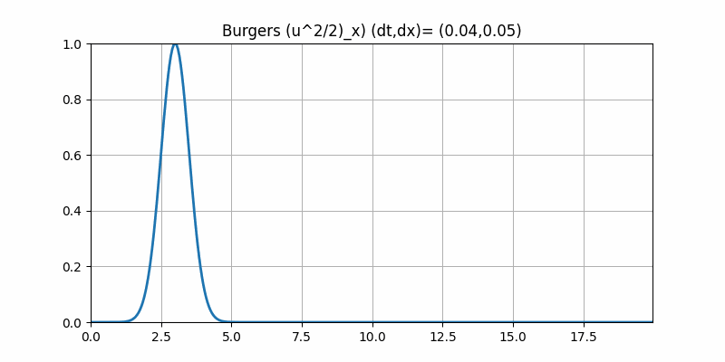
Fundamentals of Finite Volume Method
Comparison of Burgers
Non conservative
Conservative
Notice that non conservative scheme also suffers from incorrect wave speed

Slide 49
Fundamentals of Finite Volume Method
Finite Volume Method
$$u_{i}^{n+1}=u_{i}^{n}-\frac{1}{Δx}(F_{i+1/2}-F_{i-1/2})$$
Need to evaluate numerical fluxes with point wise (interface) values, $F(u(x_{i+1/2}^{-},t))$
1. Reconstruct $u$ using cell averages, ${\overline{u}}_{i}$
2. Evaluate reconstruction at the interface, $u^{*}=u(x_{i+1/2},t)$
3. Plug interface value into flux, $F(u^{*})=F_{i+1/2}$

Slide 50
Limiters and MUSCL Scheme
The best of both worlds
We know the ingredients to get conservation and avoid oscillations, but stuck with first order accuracy - even away from shocks. We are getting unnecessary diffusion even in smooth regions
Maybe we can use higher order scheme in smooth region (no diffusion) then switch to low order scheme near large gradients (no oscillations).
This is the core idea behind Flux/Slope Limiters/ "Monotonic Upstream-centered Scheme for Conservation Laws"
We need to pick 1. higher order scheme and 2. a way to switch.
(For low order scheme we are kind of stuck with the upwinding (barrier theorem) )

Slide 51
Limiters and MUSCL Scheme
Flux Limiters
$$\frac{∂\overline{u}}{∂t}+\frac{1}{Δx}(F_{i+1/2}(t)-F_{i-1/2}(t))=0$$
Recall our semi discrete form
We take each interface flux to be a convex combinations of high and low order schemes:
$$\begin{matrix}F(u_{i+1/2}) & =f_{i+1/2}^{low}-ϕ(r_{i})(f_{i+1/2}^{low}-f_{i+1/2}^{high}) \\ F(u_{i-1/2}) & =f_{i-1/2}^{low}-ϕ(r_{i-1})(f_{i-1/2}^{low}-f_{i-1/2}^{high})\end{matrix}$$
$ϕ(r_{i})$ is our switching function and
$r_{i}$ is our switching criteria.
We usually take ratio of successive gradients:
$r_{i}=\frac{u_{i}-u_{i-1}}{u_{i+1}-u_{i}}$
$ϕ=1⟹F_{i+1/2}-F_{i-1/2}=f_{i+1/2}^{high}-f_{i-1/2}^{high}$ $ϕ=0⟹F_{i+1/2}-F_{i-1/2}=f_{i+1/2}^{low}-f_{i-1/2}^{low}$

Slide 52
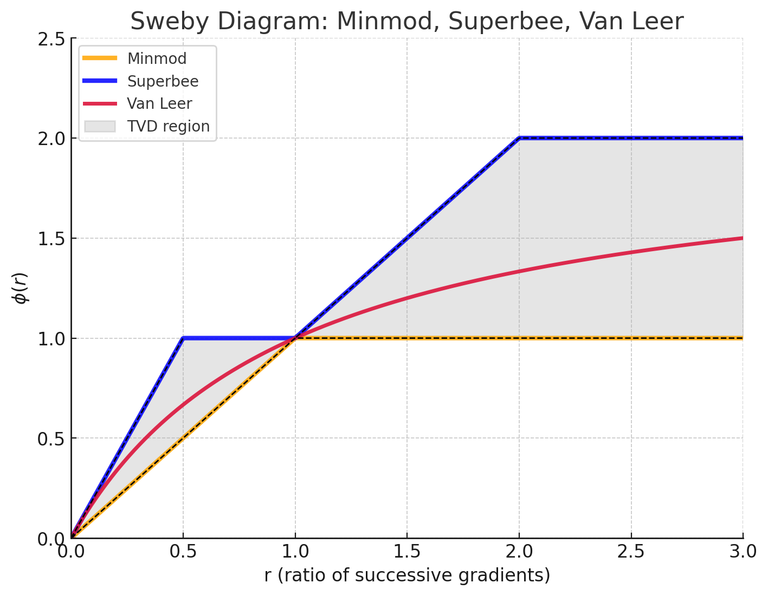
Limiters and MUSCL Scheme
Examples of limiter functions, $ϕ$
Superbee:
$$ϕ_{sb}=\text{max}(0,\text{min}(2r,1),\text{min}(r,2))$$
$$ϕ_{VL}=\frac{r+|r|}{1+|r|}$$
Van Leer:
MinMod:
$$ϕ_{mm}=\text{max}(0,\text{min}(1,r))$$
If you stay in grey area your scheme
will be monotone (not develop oscillations)

Slide 53
Limiters and MUSCL Scheme
Flux Limiters
“Least diffusive”
Superbee
Van Leer
MinMod
“More diffusive”
$$\begin{matrix}F & =f^{low}+ϕ(f^{low}-f^{high}) \\ & =(1-ϕ)f^{low}+ϕf^{high}\end{matrix}$$
Small $ϕ$ favors low order scheme (i.e. more diffuse)

Slide 54
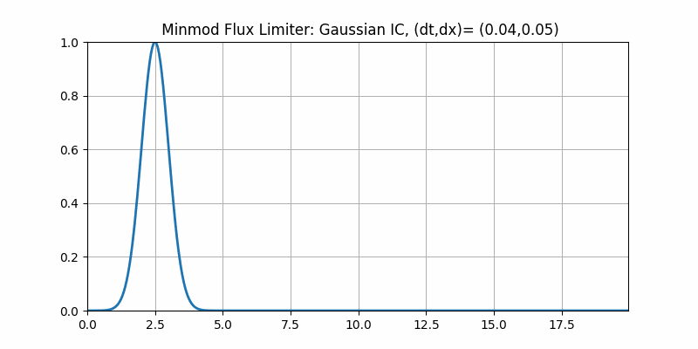
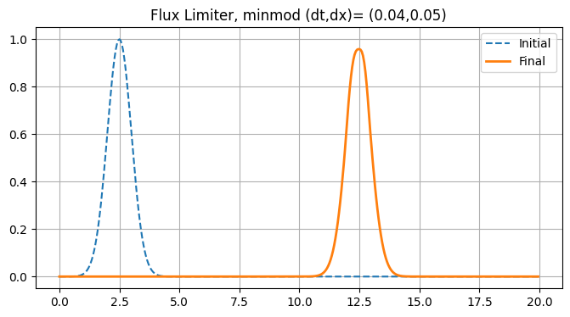
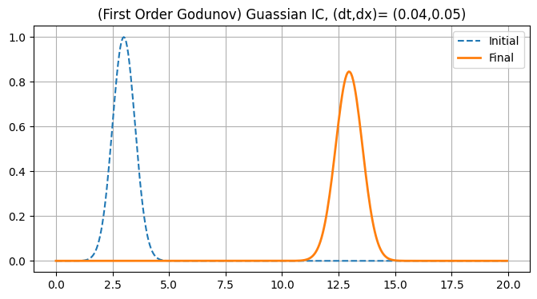
Limiters and MUSCL Scheme
Flux Limiters
We see we have some diffusion (we are using minmod so not totally unexpected), but generally we are using the high order scheme. We compare to upwinding via Godunov and see we have less diffusion.

Slide 55
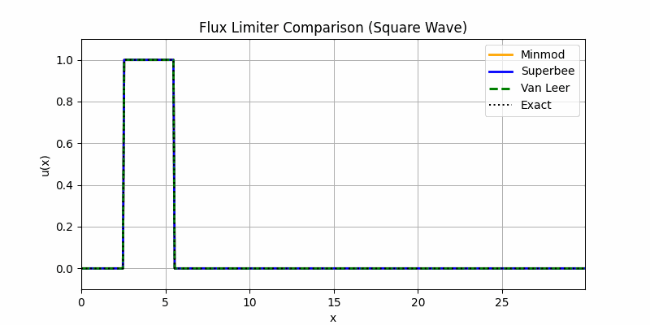
Limiters and MUSCL Scheme
Flux Limiters

Slide 56

Limiters and MUSCL Scheme
Flux Limiters limitation
What if we have a “strong shock” like Burgers?
We get stuck in the diffusive regime.

Slide 57
ENO and WENO
An alternative approach to achieving high order accuracy in smooth regions
Recall this behavior:
Despite being smooth we still fall into a diffusive regime. If we have complicated (constant “weak shock”), but smooth dynamics we may get stuck with upwinding

Slide 58
ENO and WENO
Don’t deal with it until you absolutely have to
MUSCL says: let’s detect shock by computing gradients and switch schemes to give diffusion and avoid oscillations
ENO says: Just avoid it
ENO takes a high order scheme (high order reconstruction - usually quadratic)
(So build good approximation to give to Riemann Solver and we get more accurate interface value, $u_{i+1/2}$)
But… it does this reconstruction on several meshes and picks the “smoothest” reconstruction. (i.e. it avoids shocks)
So when we are forced to interpolate across a shock we confine this to a single cell interface. This leads to much higher accuracy when we are close to shocks and we track wave front much more accurately

Slide 59
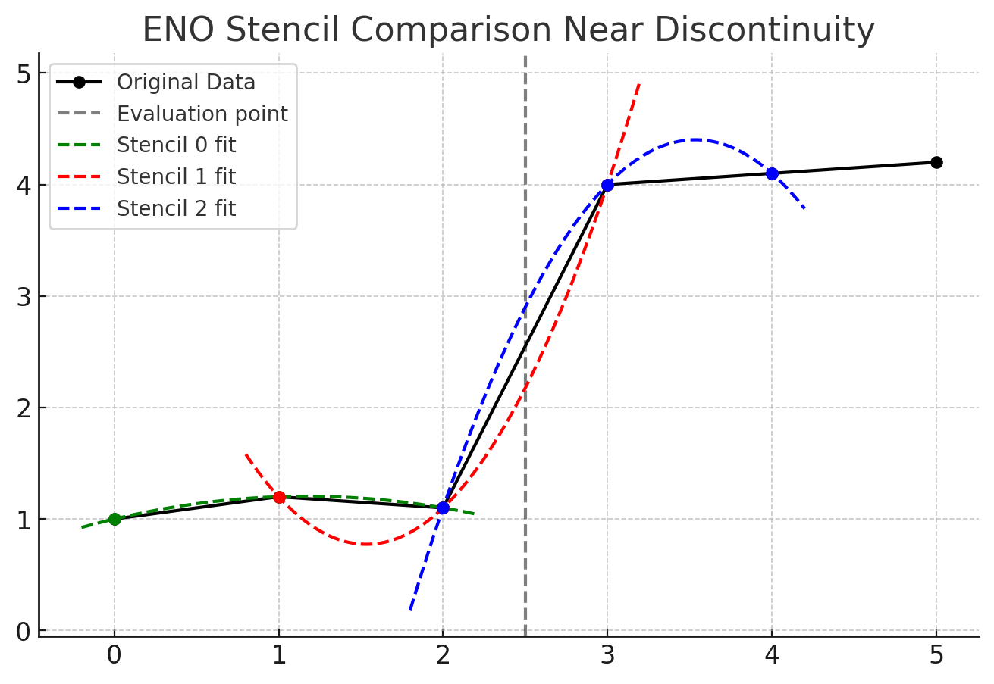
ENO and WENO
ENO Grid picking
Want reconstruction of $x=2.5$
Build 3 grids:
$$[0,1,2],[1,2,3],[2,3,4]$$
Construct polynomial on each grid
Pick “smoothest”, $p_{k}$
Evaluate $u=p_{k}(2.5)$ as the interface value
Do for other side then turn the Godunov crank

Slide 60

This is the end
Quick Recap:
1. Respect the physics
2. There is a fundamental tension between diffusion and dispersion in numerics
3. You have to decide which physics you want to respect
Thanks for listening!
Happy Birthday Austin!
If there are no questions you could ask:
1. Where does CFL/stability show up in FVM?
2. Can you just use a high order scheme and a filter to get rid of dispersion?
3. Isn’t Godunov scheme saying “solving our pde solves our pde”?

